Slide 1
Passive energy system Design
Presented by
Amruth Varagani

Slide 2
Passive energy system design
Passive Design doesn’t use any outside energy or require much special equipment, but simply takes advantage of existing natural phenomena, like the direction of the sun or the insulating properties of building materials.
Passive Design does not require mechanical heating or cooling.
Results when a building is created and simply works “on its own”. Solar passive buildings are designed to achieve thermal and visual comfort by using natural energy resources.

Slide 3
Role of Passive In Architecture
Passive in architecture regards the particular way to construct a building using the, natural movement of heat and air, passive solar gain and cooling in order to maintain a good internal comfort.
Through the use of passive design it is possible to eliminate, or at least reduce, the use of mechanical systems and the energy demand by 80% as well as the CO₂ emissions.

Slide 4
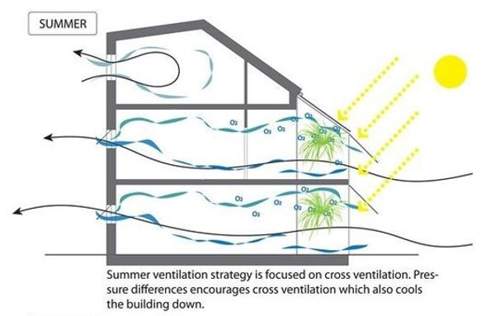
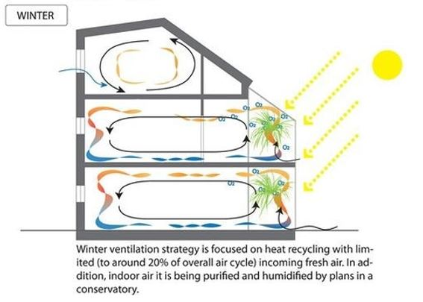
Passive solar design

Slide 5
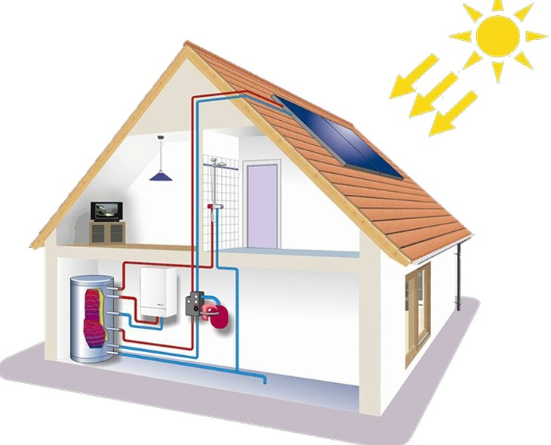
ACTIVE SOLAR DESIGN
Active Solar Design uses outside energy and equipment—like electricity and solar panels — to capture and utilize the energy of the sun. Active Design uses equipment to modify the state of the building, create energy and comfort; i.e. Fans, pumps, etc.
Active design use purchased energy to keep the
building comfortable. These strategies include
forced-air HVAC systems, heat pumps, radiant
panels, and electric lights.

Slide 6
DIFFERENTIATION BETWEEN PASSIVE SOLAR DESIGN AND ACTIVE SOLAR DESIGN
ACTIVE SOLAR DESIGN | PASSIVE SOLAR DESIGN
Active solar systems use external sources of energy or uses conventional energy sources to operate. | A passive solar system does not involve mechanical devices or the use of conventional energy sources to operate.
It usually requires expensive external equipment. | It’s usually cheaper than an active system.
Requires a lot of maintenance. | Requires little or almost no maintenance.
It’s efficiency depends on the type of equipment used. | It’s efficiency depends on the weather.
Active solar systems typically work on mechanical system. | Passive solar heating uses a phenomenon that happens naturally.
Lots of moving parts – higher failure rates. | No moving parts and works 24 hours per day.
Allows controlled and efficient gathering and distribution of energy. | Less control in gathering and distribution of energy.

Slide 7
ADVANTAGES OF PASSIVE STRATEGIES IN DESIGN
Passive solar design is highly energy efficient, reducing a building's energy demands for lighting, winter heating, and summer cooling.
Energy from the sun is free.
Passive solar design also helps conserve valuable fossil fuel resources so that they can be directed toward other uses. And it saves money.
Passive solar design also reduces greenhouse gases that contribute to global warming because it relies on solar energy, a renewable, non-polluting resource.
Energy performance: Lower energy bills all year-round

Slide 8
Continue..
Attractive living environment: large windows and views, sunny interiors, open floor plans.
Comfort: quiet (no operating noise), solid construction, warmer in winter, cooler in summer (even during a power failure)
Value: high owner satisfaction, high resale value
Low Maintenance: durable, reduced operation and repairs
Investment: independence from future rises in fuel costs, will continue to save money long after any initial costs have been recovered
Environmental Concerns: clean, renewable energy to combat growing concerns over global warming ,acid rain and ozone depletion

Slide 9
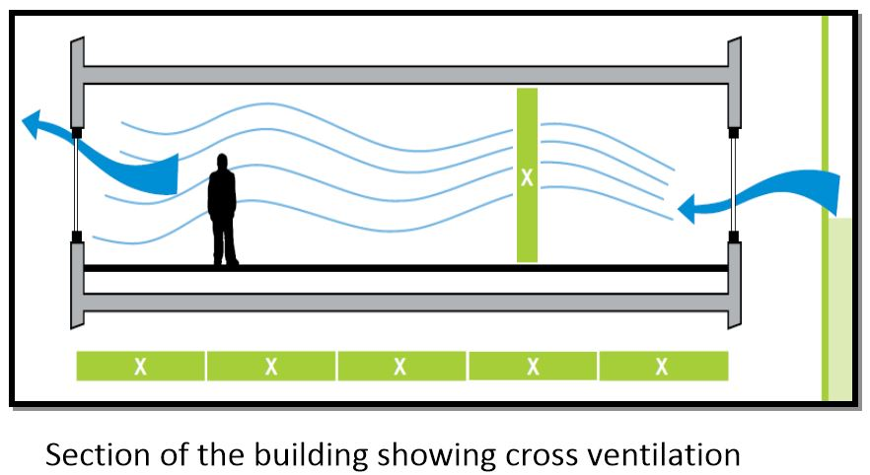
WHAT IS PASSIVE STRATEGY?
Passive design strategies use ambient energy sources instead of purchased energy like electricity or natural gas. These strategies include day lighting, natural ventilation, and solar energy.

Slide 10
PASSIVE DESIGN STRATEGIES
PASSIVE HEATING
PASSIVE COOLING
PASSIVE LIGHTING

Slide 11
PASSIVE SOLAR HEATING
A passive solar heating system is a way for the building materials to collect, store, and distribute solar energy by natural convection, conduction, and radiation.
The building itself acts as thermal mass to store the heat it collects during the day which is then released during the night.
By installing high performance windows with insulated frames, multiple glazing, low-ecoatings, may reduce the heat loss by 50 to 75 %.
There are five parts of a passive solar heating system
1) Aperture 2) Absorber 3) Thermal Mass 4) Distribution 5) Control

Slide 12
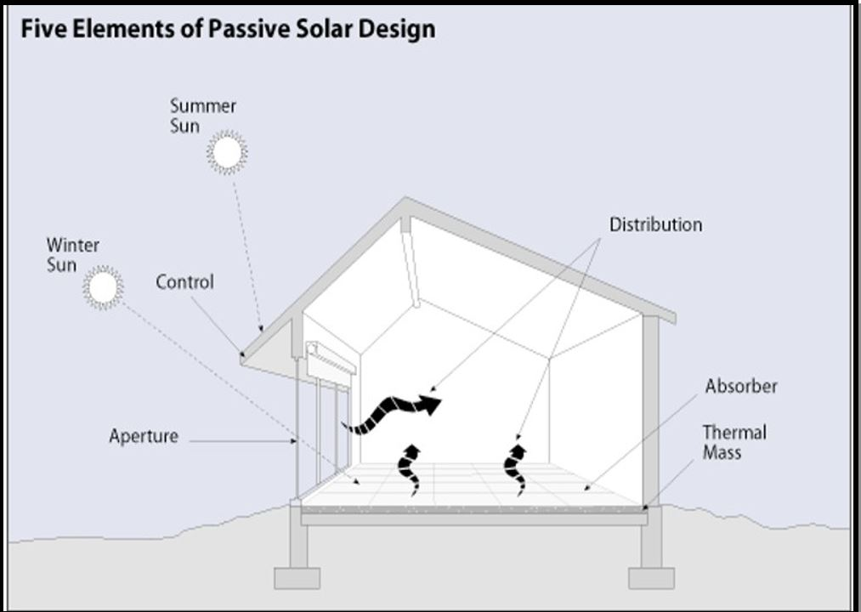
PARTS OF PASSIVE SOLAR HEATING SYSTEM

Slide 13
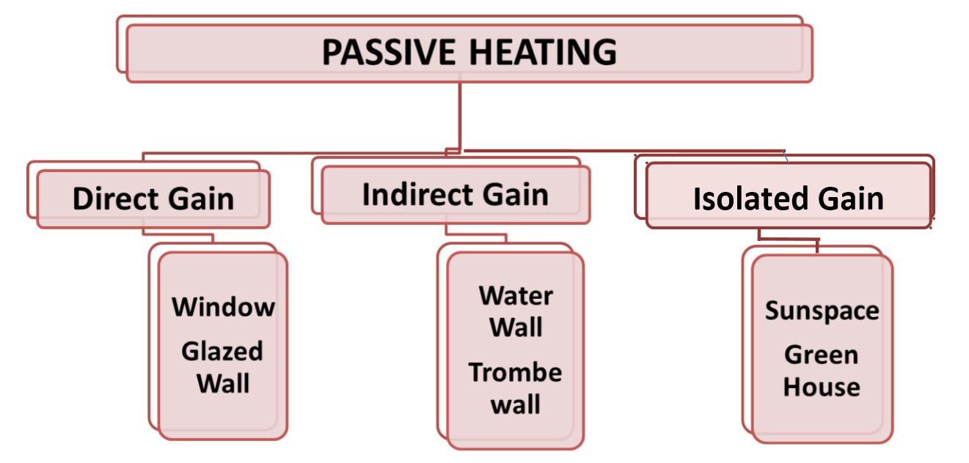

Slide 14
Direct gain method
Direct gain method is the simplest method where the space of the building is directly heated by sunlight.
The building itself acts as a storage device for the heat.
Heat always travels from warmer materials to cooler materials.
This process is reversed during the night to provide heat to the building. The heat is re-radiated out from the building’s core (inner walls/floors) and heats the interior space during the night. This continues as long as the core building is warmer than the interior space.

Slide 15
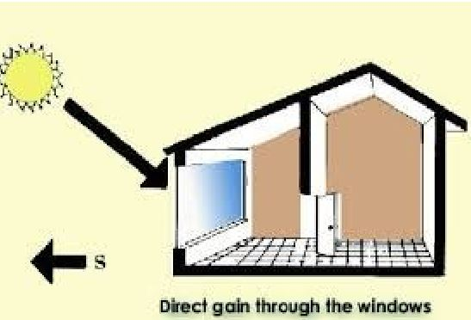
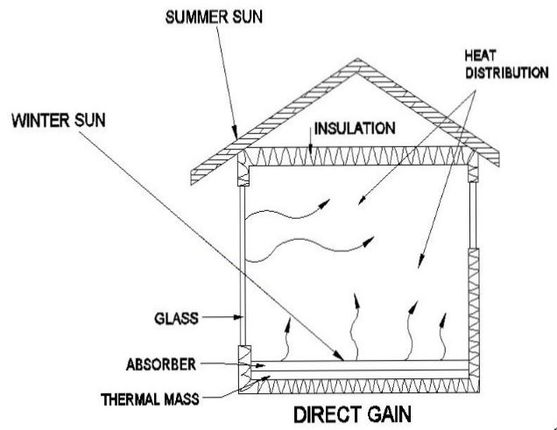
Direct gain method

Slide 16
INDIRECT GAIN - TROMBE WALL
A Trombe wall is the most common indirect gain approach. A Trombe wall is a 8-16” thick south facing masonry wall.
A single or double layer of glass is placed approximately one inch in front of the wall.
The glass is sealed to the wall so no air can leak outside. Solar energy goes through the glass, hits the masonry wall, is absorbed, stored and radiated on the other side into the living space.
A Trombe wall can radiate heat for several hours after dark.

Slide 17
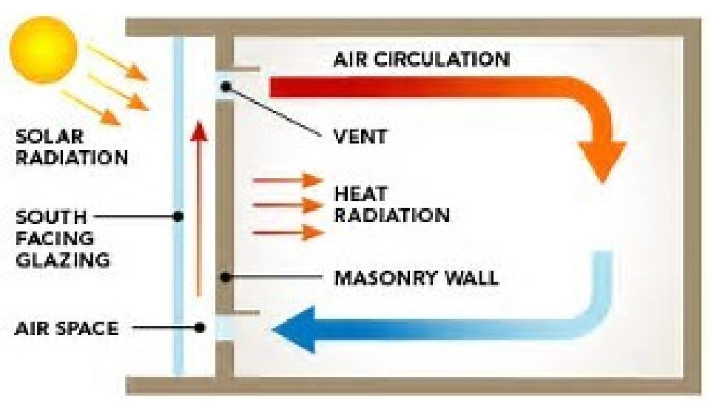
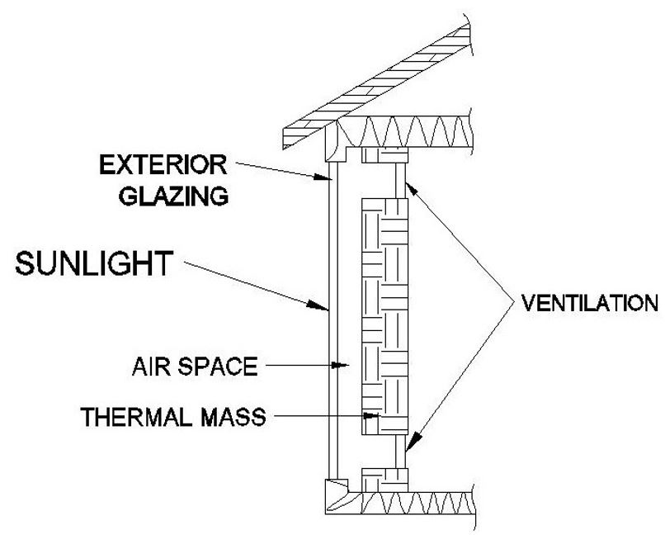
INDIRECT GAIN - TROMBE WALL

Slide 18
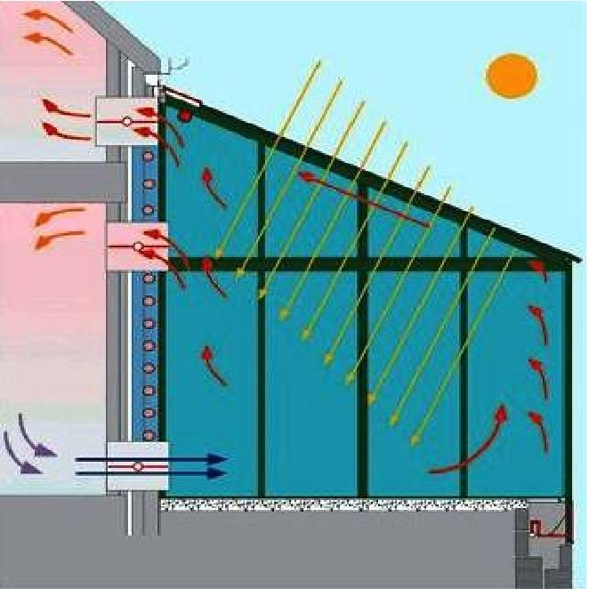
ISOLATED GAIN - SUNSPACE
A sunspace is a room designed to capture heat.
Vertical windows capture the heat just like the direct
and indirect gain system.
The same masonry walls or water drums are used
as thermal mass.
Distribution is achieved through ceiling and floor
vents, windows/doors, and/or fans.
The sunspace is often separated by the rest of the
building using windows or doors. This protects the
home against the sun’s fluctuating temperatures.

Slide 19
PASSIVE COOLING
Passive cooling systems are least expensive means of cooling a home which maximizes the efficiency of the building envelope without any use of mechanical devices.
It rely on natural heat-sinks to remove heat from the building. They derive cooling directly from evaporation, convection, and radiation without using any intermediate electrical devices.
All passive cooling strategies rely on daily changes in temperature and relative humidity and climatic conditions.
These design strategies reduce heat gains to internal spaces.

Slide 20
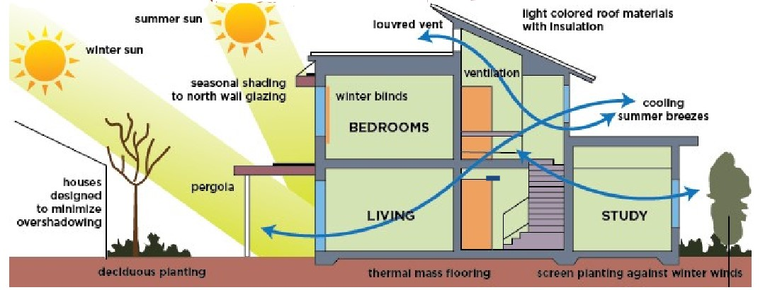
PASSIVE COOLING

Slide 21
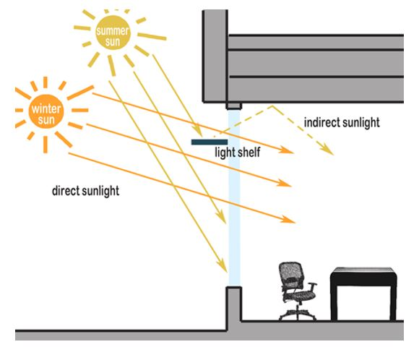
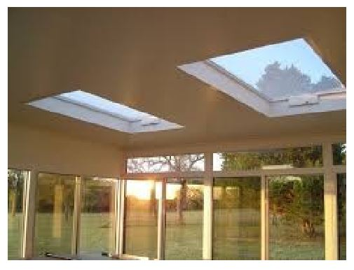
passive Lighting
Installing skylights, highly-placed clerestory windows, and/or solar tubes (also known as light tubes) to help illuminate naturally darker rooms.
Incorporating reflective surfaces like light shelves, which help reflect sunlight coming in through a window up toward the ceiling.

Slide 22
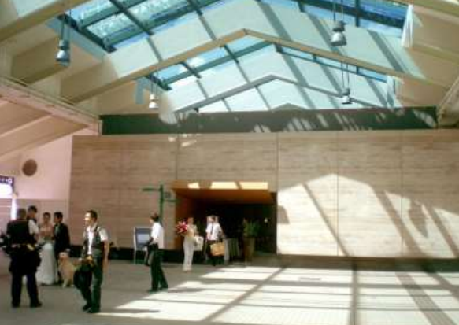
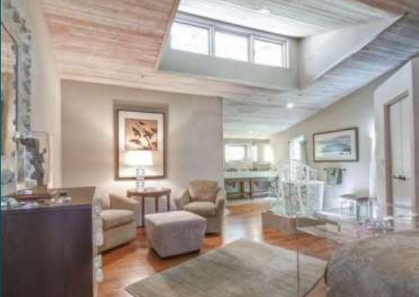
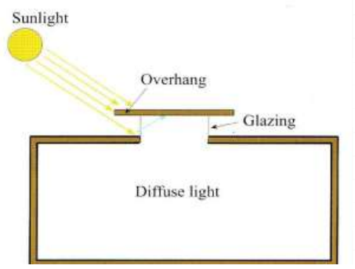
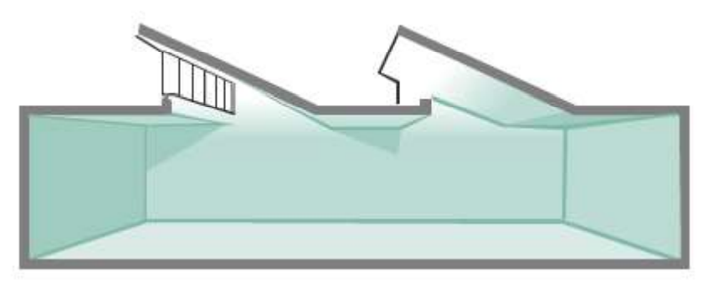
passive Lighting
SKY LIGHTS
CLERSTOREY
MONITOR LIGHTING
SAW TOOTH LIGHTING

Slide 23
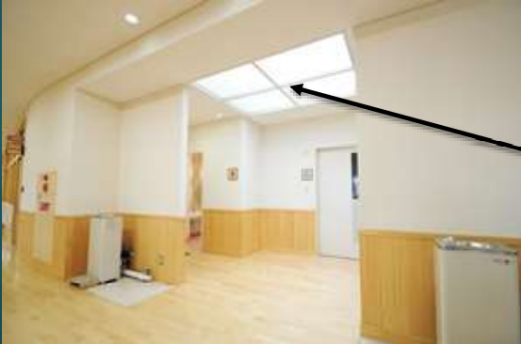
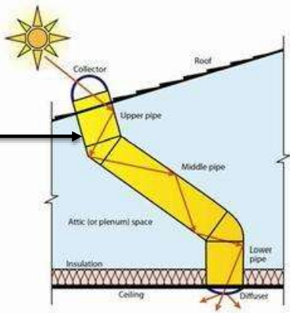
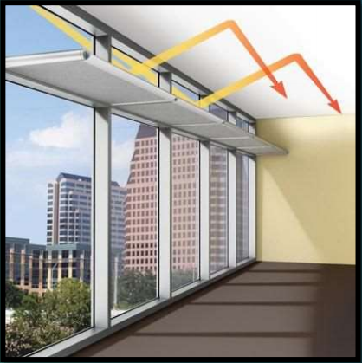
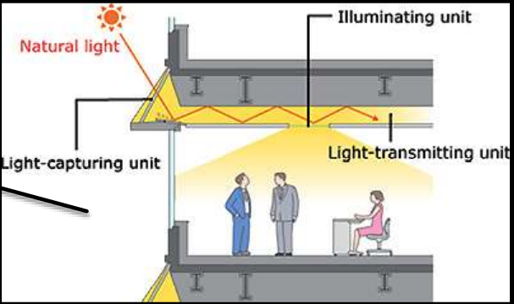
passive Lighting
SOLAR/LIGHT TUBES
LIGHT SHELVES

Slide 24
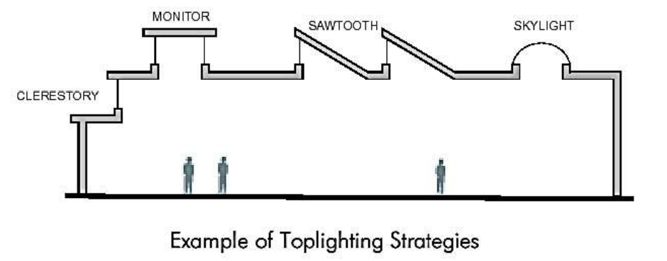
passive Lighting

Slide 25
NATURAL VENTILATION
Natural ventilation is the process of supplying and removing air through a space by natural means it can be achieved with openable windows or trickle vents.
Outdoor breezes create air movement through the house interior by the 'push pull' effect of positive air pressure on the windward side and negative pressure (suction) on the leeward side.
The windows, play a dominant role in inducing indoor ventilation due to wind forces.

Slide 26
DIFFERENT TECHNIQUES ARE USED TO ACHIEVE NATURAL VENTILATION
WIND TOWER : In a wind tower, the hot air enters the tower through the openings, gets cooled, and thus becomes heavier and sinks down. The tower walls absorb heat during daytime and release it at night, warming the cool night air in the tower.
COURTYARD EFFECT : Due to incident solar radiation in a courtyard, the air gets warmer and rises. Cool air from the ground level flows through the louvered openings of rooms surrounding a courtyard, thus producing air flow. At night, the warm roof surfaces get cooled by convection and radiation.
STACK EFFECT : Pressure difference between the outside air and the air inside the building caused by difference in temperature

Slide 27
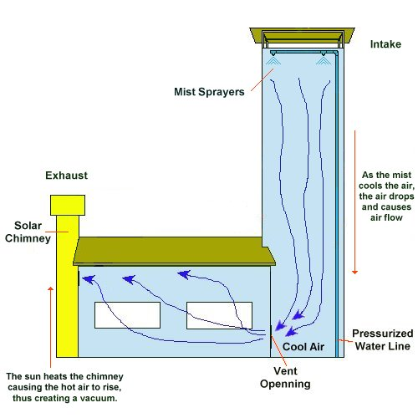
WIND TOWER

Slide 28
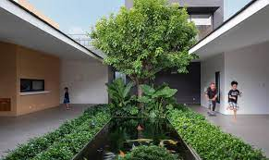
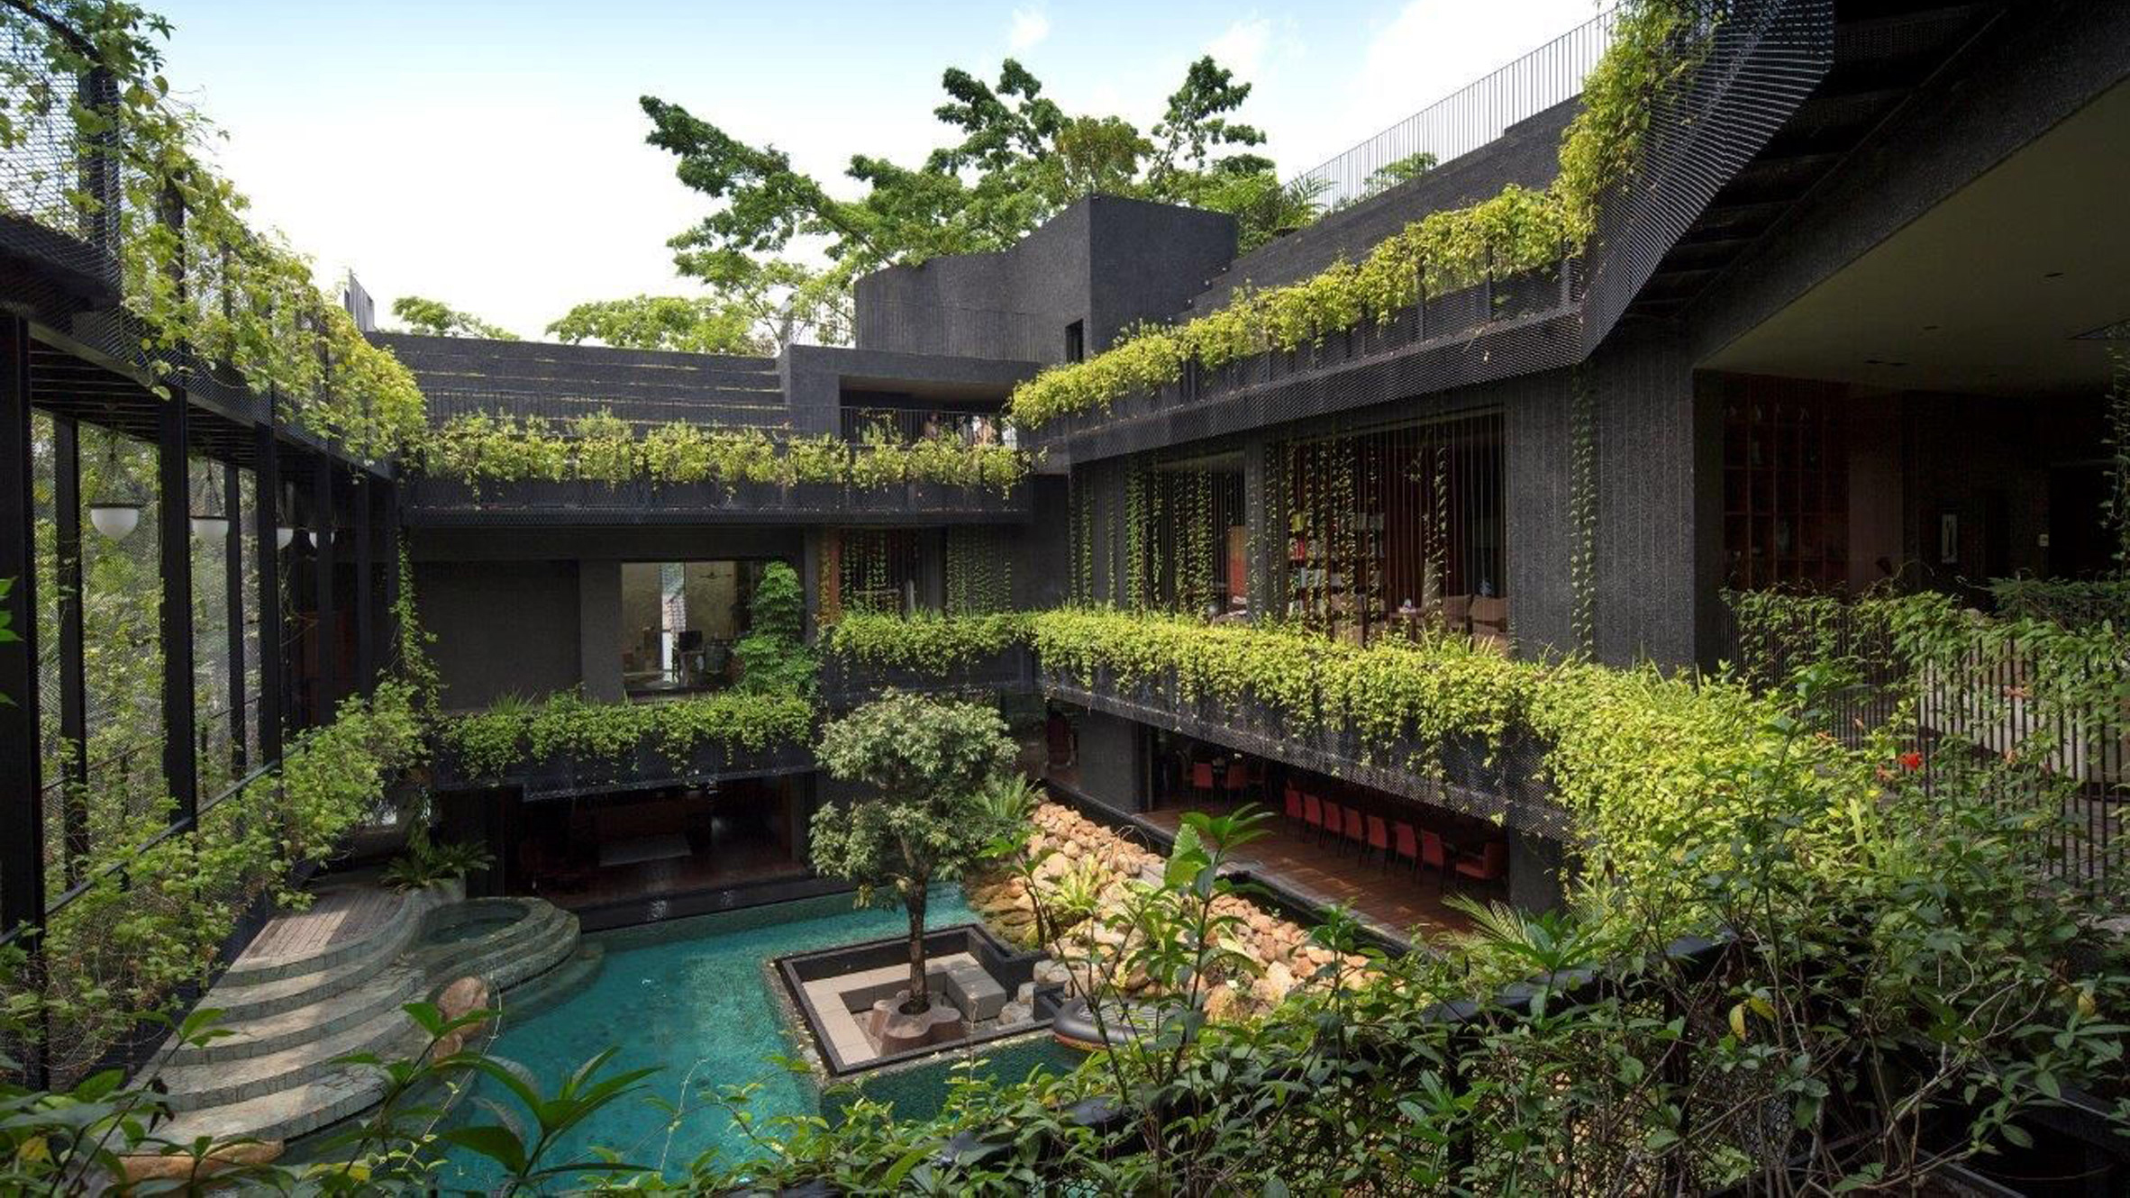
COURTYARD EFFECT

Slide 29
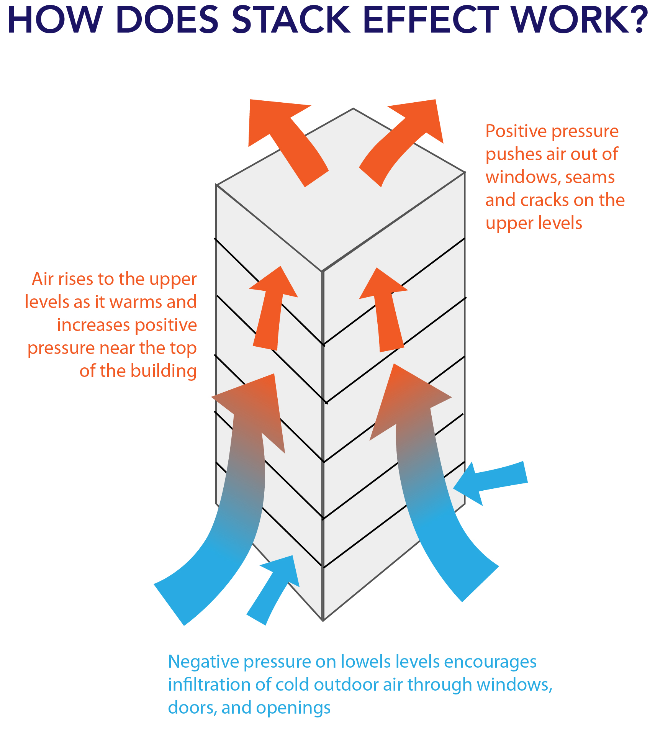
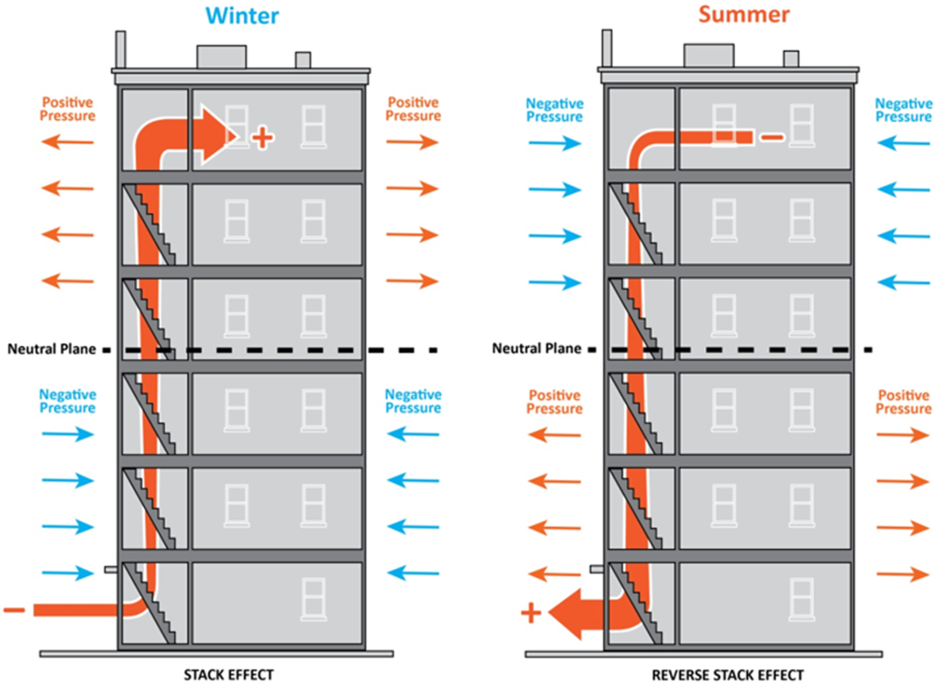
STACK EFFECT

Slide 30
NATURAL VENTILATION EXTERNAL FEATURES
Orientation of buildings
Form of buildings
Position of openings
Size of openings
Opening types
Cross ventilation

